Slide 1
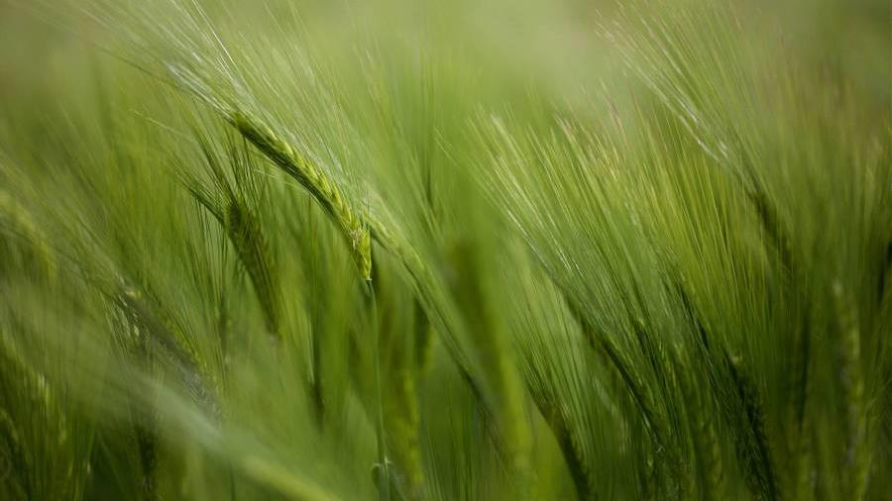
AGRO HELP SYSTEM
UNDER THE SUPERVISION OF
FIGLU MOHANTY MAM

Slide 2

Team members
21100300054 P . Vaishnavi
2110030203 M . Manisri
2110030218 G . Navya
2110030233 C. Rishika

Slide 3
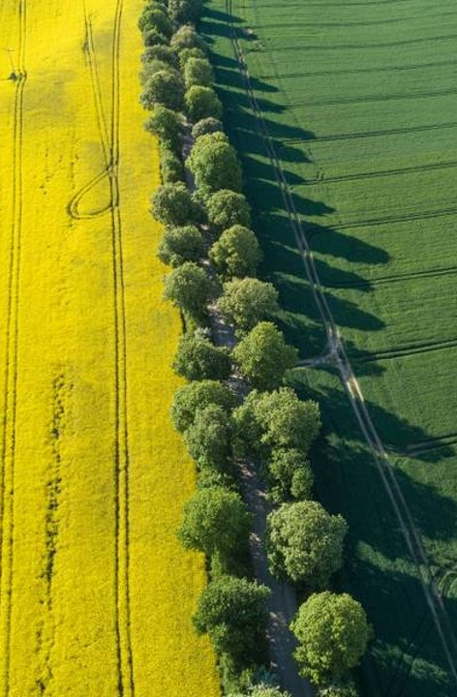
WHAT IS AGRO HELP SYSTEM
.Agroecology helps to protect, restore and improve agriculture and food systems in the face of climate shocks and stressors.
. Agroecology is a holistic and integrated approach that simultaneously applies ecological and social concepts and principles to the design and management of sustainable agriculture and food systems. It seeks to optimize the interactions between plants, animals, humans and the environment.
. Help the farmers to farm in easy and simple way.

Slide 4



HOW IT WORKS
. The website exclusively for Farmers
. The Farmers has to first signup by giving required information and can access the website later by logging in
. The Farmers can search their related pesticides and fertilizer
. There will be a discussion section where Farmers can interact with the warehouse
Authentic
Tested

Slide 5

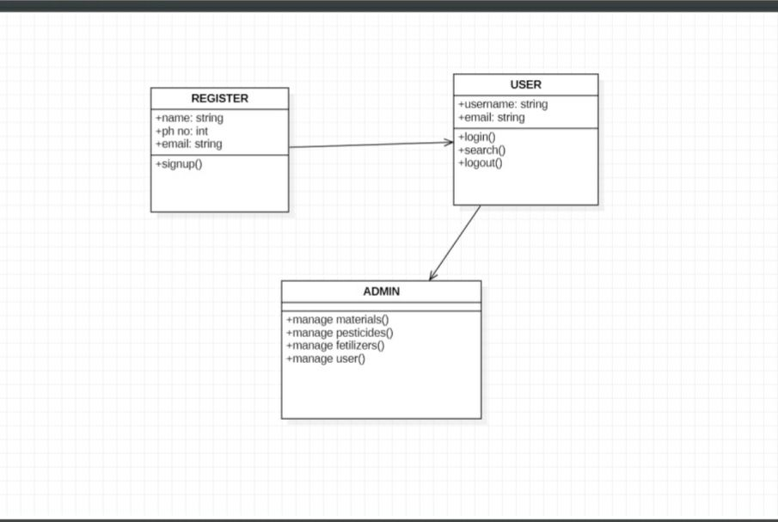
CLASS DIAGRAM
​

Slide 6
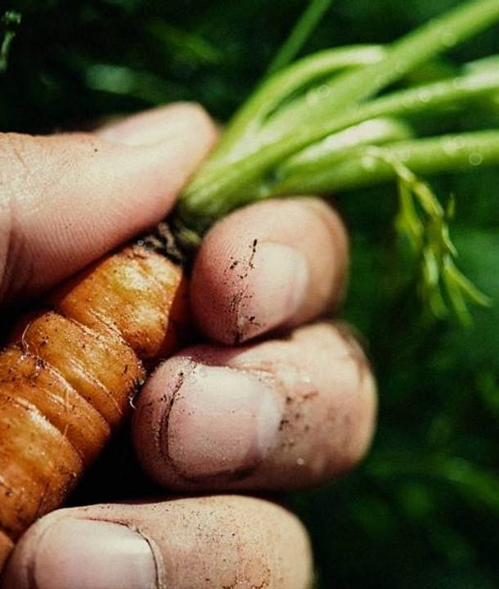
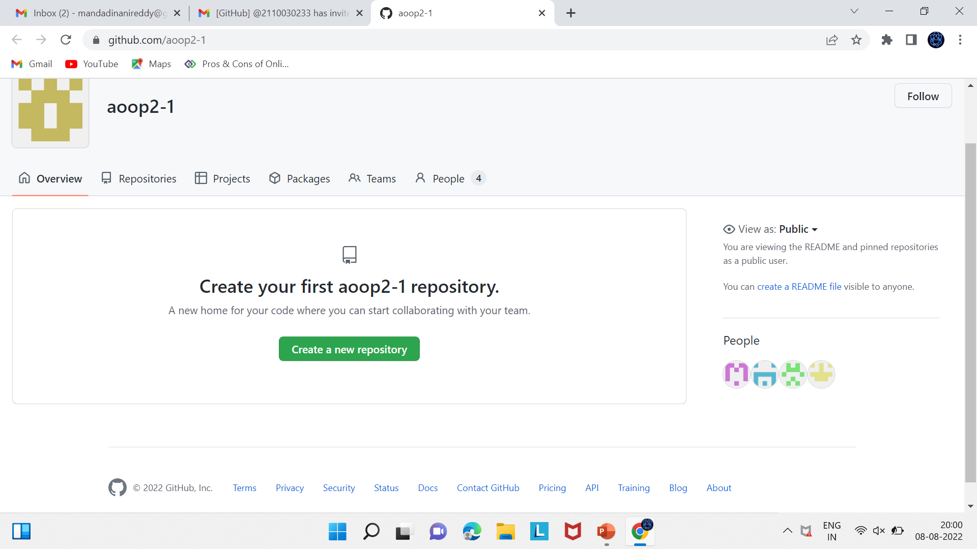
Git hub setup
https://github.com/aoop2-1
​
​
​
$2B
$1B
$3B​

Slide 7
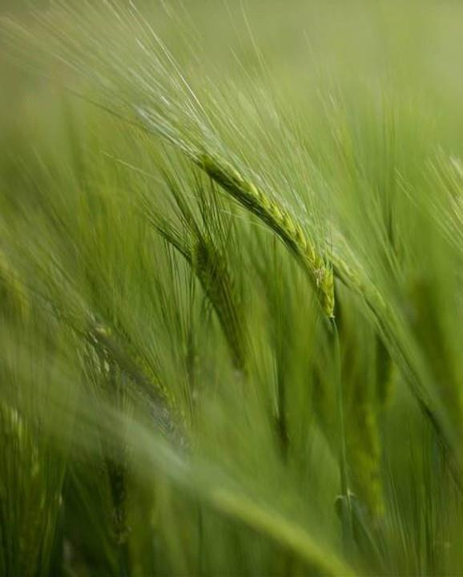
contribution
​
ID NO | NAME | WORK DONE
2110030054 | P . Vaishnavi | Research & class diagram
2110030203 | M . Manisri | Research &ppt
2110030218 | G . Navya | Research
2110030233 | C . Rishika | Research
​
Oct 20xx
May 20xx
Feb 20xx

Slide 8
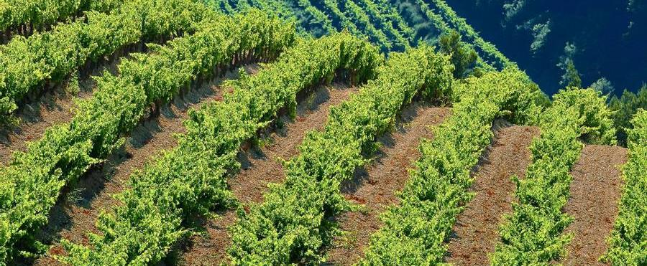
THANK YOU !

